Slide 1
Decision Tree Introduction
Decision tree builds classification or regression models in the form of a tree structure.
It breaks down a dataset into smaller subsets with increase in depth of tree.
The final result is a tree with decision nodes and leaf nodes
A decision node (e.g., Outlook) has two or more branches (e.g., Sunny, Overcast and Rainy).
Leaf node (e.g., Play) represents a classification or decision.
The topmost decision node in a tree which corresponds to the best predictor is called root node.
Decision trees can handle both categorical and numerical data.

Slide 2
Decision Tree - Types
Categorical Variable Decision Tree: Decision Tree which has categorical target variable then it called as categorical variable decision tree.
Continuous Variable Decision Tree: Decision Tree which has continuous target variable then it is called as Continuous Variable Decision Tree.

Slide 3
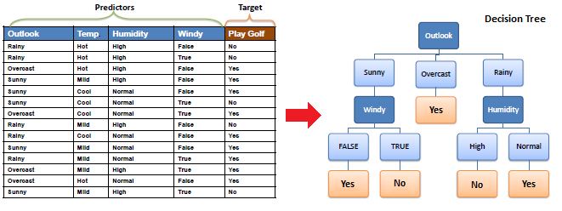
Decision Tree Introduction

Slide 4
Decision Tree – Important Terminologies
Root Node: It represents entire population or sample and this further gets divided into two or more homogeneous sets.
Splitting: It is a process of dividing a node into two or more sub-nodes.
Decision Node: When a sub-node splits into further sub-nodes, then it is called decision node.
Leaf/ Terminal Node: Nodes with no children (no further split) is called Leaf or Terminal node.
Pruning: When we reduce the size of decision trees by removing nodes (opposite of Splitting), the process is called pruning.
Branch / Sub-Tree: A sub section of decision tree is called branch or sub-tree.
Parent and Child Node: A node, which is divided into sub-nodes is called parent node of sub-nodes where as sub-nodes are the child of parent node.

Slide 5
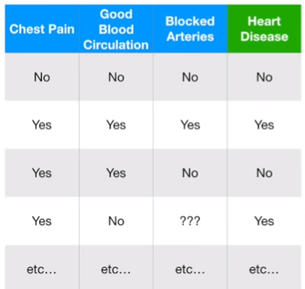
Decision Tree Introduction
Lets take an example of a patient’s health data.
(Total 303 observations)
In this example we want to create a tree that uses chest pain, good blood circulation and blocked arteries status to predict whether the person has a heart disease or not.
The first thing we want to know is,
what should be our root node ?
Chest Pain, Good Blood Circulation or Blocked Arteries ?

Slide 6
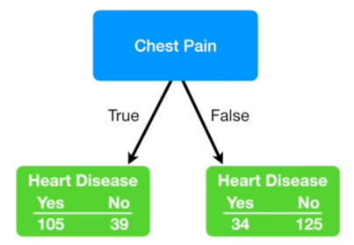
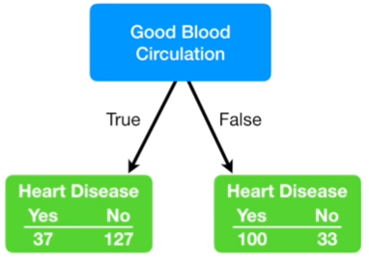
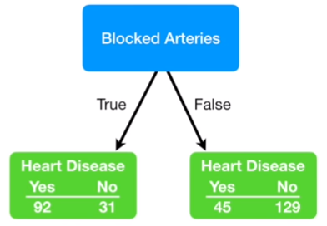
Decision Tree Introduction
The first thing we want to know is, what should be our root node ?
Chest Pain, Good Blood Circulation or Blocked Arteries ?
Lets start by looking each feature separately.

Slide 7
Decision Tree Introduction
The Goal is: what should be our root node ?
Chest Pain, Good Blood Circulation or Blocked Arteries ?
We looked at how well the ‘Chest Pain’ separated patients with and without heart disease. It did ‘OK’ but it was not perfect.
All the leaf nodes contains both ‘Yes – Heart Disease’ as well as ‘No – Heart Disease’.
Same is the scenario for other features as well.
Because none of the lead nodes are 100% “YES Heart Disease” or “100% - NO Hear Disease”, they are all considered as impure.
To determine which separation is best, we need a way to measure and compare this impurity.

Slide 8
Decision Tree – Algorithms
The Goal is: what should be our root node ?
Chest Pain, Good Blood Circulation or Blocked Arteries ?
Following algorithms are used to measure impurity :
Gini Index / Gini Coefficient / Gini Ratio
ID3
Chi Squared
Reduction in Variation

Slide 9
Decision Tree – Gini Index
Gini index says, if we select two items from a population at random then they must be of same class and probability for this is 1 if population is pure.
It works with categorical target variable “Success” or “Failure” and Numerical Data.
It performs only Binary splits
Higher the value of Gini higher the homogeneity.
CART (Classification and Regression Tree) uses Gini method to create binary splits.
Steps to Calculate Gini for a split
Calculate Gini for sub-nodes, using formula (1 - p² - q²).
Where, p = probability of “yes”
q = probability of “no”
Calculate Gini for split using weighted Gini score of each node of that split
Note: Gini index is often used in finance/economic decision making.
The Gini index is a statistical measure of distribution often used as a gauge of economic inequality.
A society that scores 0.0 on the Gini scale has perfect equality in income distribution. Higher the number over 0 higher the inequality, and the score of 1.0 (or 100) indicates total inequality where only one person corners all the income

Slide 10
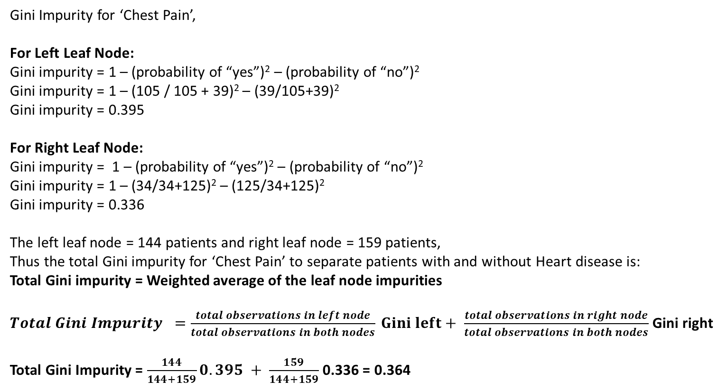
Decision Tree – Gini Index Categorical
Step 1: Gini index calculation for root node
Gini Impurity for ‘Chest Pain’,
For Left Leaf Node:
Gini impurity = 1 – (probability of “yes”)² – (probability of “no”)²
Gini impurity = 1 – (105 / 105 + 39)² – (39/105+39)²
Gini impurity = 0.395
For Right Leaf Node:
Gini impurity = 1 – (probability of “yes”)² – (probability of “no”)²
Gini impurity = 1 – (34/34+125)² – (125/34+125)²
Gini impurity = 0.336
The left leaf node = 144 patients and right leaf node = 159 patients,
Thus the total Gini impurity for ‘Chest Pain’ to separate patients with and without Heart disease is:
Total Gini impurity = Weighted average of the leaf node impurities
${Total Gini Impurity }^{ }=\frac{total observations in left node}{total observations in both nodes} Gini left+ \frac{total observations in right node}{total observations in both nodes}$ Gini right
Total Gini Impurity = $\frac{144}{144+159}0.395 + \frac{159}{144+159}$ 0.336 = 0.364

Slide 11
Decision Tree – Gini Index
Step 1: Gini index calculation for root node
Gini impurity for Chest Pain = 0.364
Gini impurity for Good Blood Circulation = 0.360
Gini impurity for Blocked Arteries = 0.381
Good Blood Circulation has the lowest impurity
i.e.
It separates patients with and without heart disease the best.
Hence we will use it as the root of the tree.

Slide 12
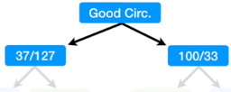
Decision Tree – Gini Index Categorical
Step 1: Gini index calculation for root node
When we divide all of the patients using Good Blood Circulation,
we ended up with “impure” leaf nodes.
Each leaf contained a mixture of patients with and without Heart Disease.

Slide 13
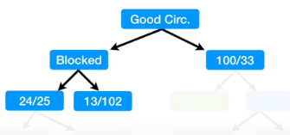
Decision Tree – Gini Index Categorical
Step 2: Gini index calculation for decision node
Now we need to figure how well Chest Pain and Blocked Arteries separate these 164 (37+127) patients
Gini impurity for Chest Pain = 0.3
Gini impurity for Blocked Arteries = 0.290
Since Blocked Arteries has lower Gini impurity, we will use it at this node to separate patients

Slide 14
Decision Tree – Gini Index Categorical
Step 3: Gini index calculation for last decision node
Now we need to figure how well Chest Pain separate these 49 (24 + 25) patients:
Gini impurity calculated at 2nd level for Chest Pain = 0.3
Now we calculate Gini impurity for left node.
IF : Gini impurity of left node > Gini impurity of Chest Pain (0.3)
We further classify the left node based on the remaining feature, here Chest Pain
ELSE: (Gini index of left node < Gini impurity of Chest Pain (0.3))
That means, the current node fairly classify the variables, Hence we do not further classify the observations in the node and stop there.

Slide 15
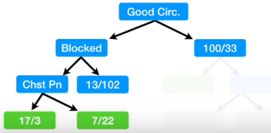
Decision Tree – Gini Index Categorical
Step 3: Gini index calculation for last decision node
Now we need to figure how well Chest Pain separate these 49 (24 + 25) patients:
Gini impurity calculated at 2nd level for Chest Pain = 0.3
Gini index of left node = 0.4998
Hence we further classify the left node based on ‘Chest Pain’
Now, Gini index of last left node = 0.2550
Which is less than Gini index of ‘Chest Pain’ calculated above (0.4998). Hence we stop here.

Slide 16
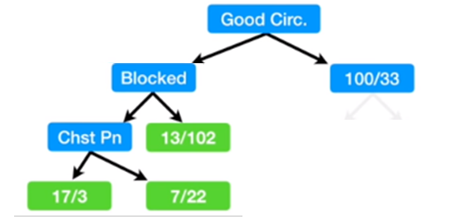
Decision Tree – Gini Index Categorical
Step 3: Gini index calculation for last decision node
Gini impurity calculated at 2nd level for Chest Pain = 0.3
Gini index of left node = 0.1987
Here impurity of lower node is (0.1987) < upper node (0.3)
Hence the impurity is lower if we do not separate patients using “Chest Pain”.
Hence we make it a leaf node and do not classify it further.

Slide 17
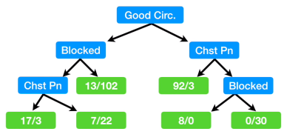
Decision Tree – Gini Index Categorical
Step 4: Gini index calculation for Right Side
We follow the exact same steps as we did on the left side:
Calculate all of the Gini impurity scores.
If the node itself has the lowest score, then there is no point in separating the patients any more and it becomes a leaf node.
If separating the data results in an improvement, then pick the separation with the lowest impurity value.

Slide 18
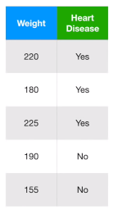
Decision Tree – Gini Index Numeric Data
Suppose we have Numeric Data like this. Then how do Gini Index work on Numeric Data ?
It performs the following steps:

Slide 19
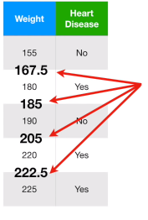
Decision Tree – Gini Index Numeric Data
Step 1: Sort the Patients by weight, lowest to highest
Step 2: Calculate the adjacent weights
(155 + 180)/2 = 167.5
(180 + 190)/2 = 185
…

Slide 20
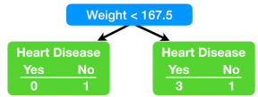
Decision Tree – Gini Index Numeric Data
Step 3: Calculate Gini impurity for each average weight.
e.g.
Gini impurity = 0
Gini impurity = 0.375
Gini impurity for Weight < 167.5 = Weighted average of the two leaves
Gini impurity for Weight < 167.5 = 0.336 ~ 0.3

Slide 21
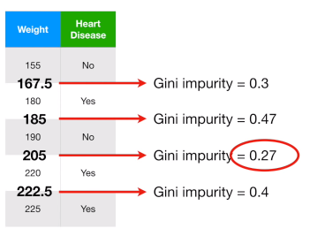
Decision Tree – Gini Index Numeric Data
Step 4: Find Root Element
Get the lowest impurity value and separate using the same.
Here for weight 205, we get the lowest impurity value, hence we use this as the root element.

Slide 22
Decision Tree – ID3
ID3 is the core algorithm for building decision trees.
ID3 uses Entropy and Information Gain to construct a decision tree.
Entropy
A decision tree is built top-down from a root node and involves partitioning the data into subsets that contain instances with similar values (homogeneous).
ID3 algorithm uses entropy to calculate the homogeneity of a sample.
If the sample is completely homogeneous the entropy is zero
If the sample is equally divided then it has entropy of one.

Slide 23
Decision Tree – ID3
ID3 is the core algorithm for building decision trees.
ID3 uses Entropy and Information Gain to construct a decision tree.
Information Gain
The information gain is based on the decrease in entropy after a data-set is split on an attribute.
Constructing a decision tree is all about finding attribute that returns the highest information gain
(i.e., the most homogeneous branches)

Slide 24
Decision Tree – ID3
Example: Say we have the below dataset

Slide 25
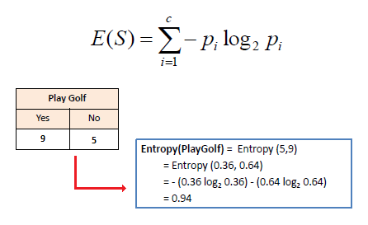
Decision Tree – ID3
ID3 performs the following steps to select the root node and further decision nodes.
1. Sample Entropy of target
5/(5 + 9) = 0.3571 ~ 0.36
9/(5 + 9) = 0.6428 ~ 0.64

Slide 26
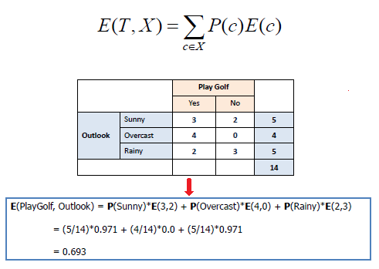
Decision Tree – ID3
Step 2: Calculate Information Gain
This is done in 2 steps:
Step 2.1: Calculate Entropy of each feature with target as below:

Slide 27
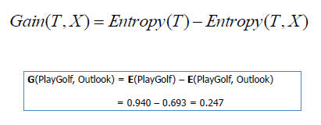
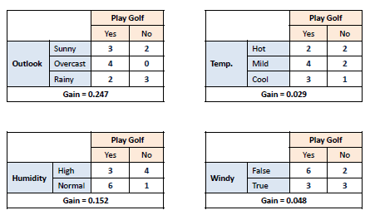
Decision Tree – ID3
Step 2: Calculate Information Gain
Step 2.2 : Calculate Information gain of each feature with target as below:
By the end of Step 2, we get Gain for each variable with the target

Slide 28
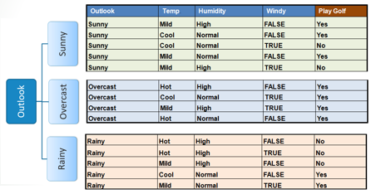
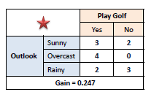
Decision Tree – ID3
Step 3:
Choose attribute with the largest information gain as the decision node,
divide the dataset by its branches and repeat the same process on every branch

Slide 29
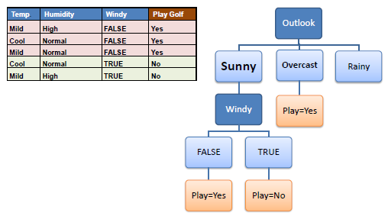
Decision Tree – ID3
Step 4a: A branch with entropy of 0 is a leaf node.
Step 4b: A branch with entropy more than 0 needs further splitting.
Step 5: The ID3 algorithm is run recursively on the non-leaf branches, until all data is classified.

Slide 30
Decision Tree – Horizontal Effect & Pruning
It is really difficult to get the optimal size in a decision tree.
A tree that is too large risks overfitting the training data and poorly generalizing to new samples.
A small tree might not capture important structural information about the sample space.
However, it is hard to tell when a tree algorithm should stop because it is impossible to tell if the addition of a single extra node will dramatically decrease error.
This problem is known as the horizon effect.
A common strategy is to grow the tree until each node contains a small number of instances then use pruning to remove nodes that do not provide additional information.
Pruning should reduce the size of a learning tree without reducing predictive accuracy.

Slide 31
Decision Tree – Horizontal Effect & Pruning
There are many techniques for tree pruning.
Some are:
Reduced Error Pruning
Cost Complexity Pruning
Reduced Error Pruning:
One of the simplest forms of pruning is reduced error pruning.
Starting at the leaves, each node is replaced with its most popular class.
If the prediction accuracy is not affected then the change is kept.
While somewhat naive, reduced error pruning has the advantage of simplicity and speed.

Slide 32
Decision Tree – Advantages
Less data cleaning required: It requires less data cleaning compared to some other modelling techniques.
Fair Resistance to Outliers: It is not influenced by outliers and missing values to a fair degree.
Data type is not a constraint: It can handle both numerical and categorical variables.
Non Parametric Method: Decision tree is considered to be a non-parametric method. This means that decision trees have no assumptions about the space distribution and the classifier structure

Slide 33
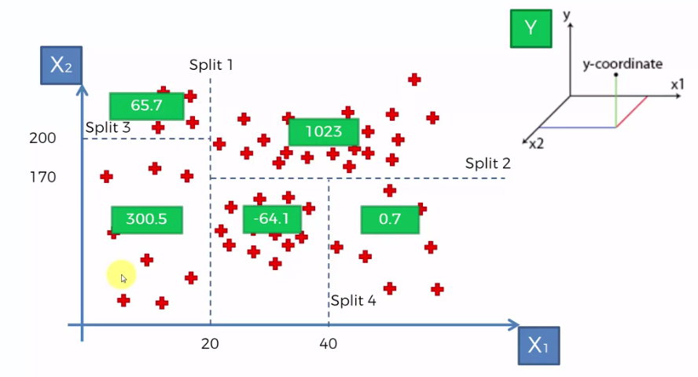
Decision Tree Regressor
X1, X2 are independent variables.
We need to predict y
Here splits happen and then the average of each leaf is taken for predicting the value.

Slide 34
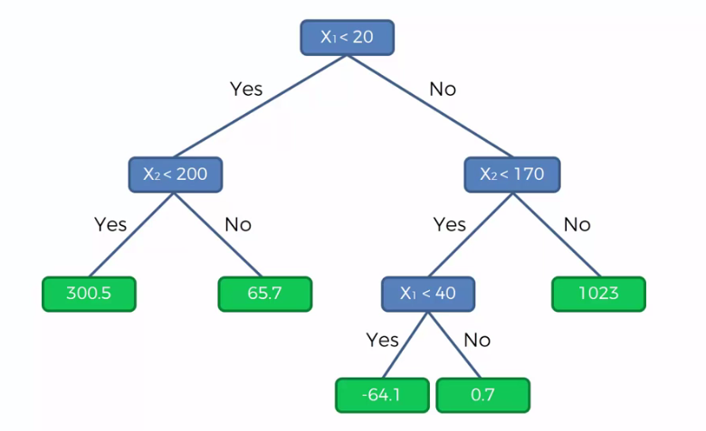
Decision Tree Regressor
X1, X2 are independent variables.
We need to predict y
Here splits happen and then the average of each leaf is taken for predicting the value.

